Slide 1
Hotel Reservation Analysis with SQL
Data Insights and Trends
Presented by Nihat Rzayev

Slide 2
Overview
Analyze hotel reservation data to gain insights into guest preferences and booking trends.
Tools Used: SQL for querying and analyzing the dataset.
Dataset Details: Includes booking ID, number of adults and children, number of weekend and weekday nights, meal plan, room type, lead time, arrival date, market segment, average price per room, and booking status.

Slide 3
Slide 3: Dataset Columns
Booking_ID: Unique identifier for each reservation.
no_of_adults: Number of adults in the reservation.
no_of_children: Number of children in the reservation.
no_of_weekend_nights: Nights reserved on weekends.
no_of_week_nights: Nights reserved on weekdays.
type_of_meal_plan: Chosen meal plan.
room_type_reserved: Type of room reserved.
lead_time: Days between booking and arrival.
arrival_date: Date of arrival.
market_segment_type: Market segment of the reservation.
avg_price_per_room: Average price per room.
booking_status: Status of the booking.

Slide 4
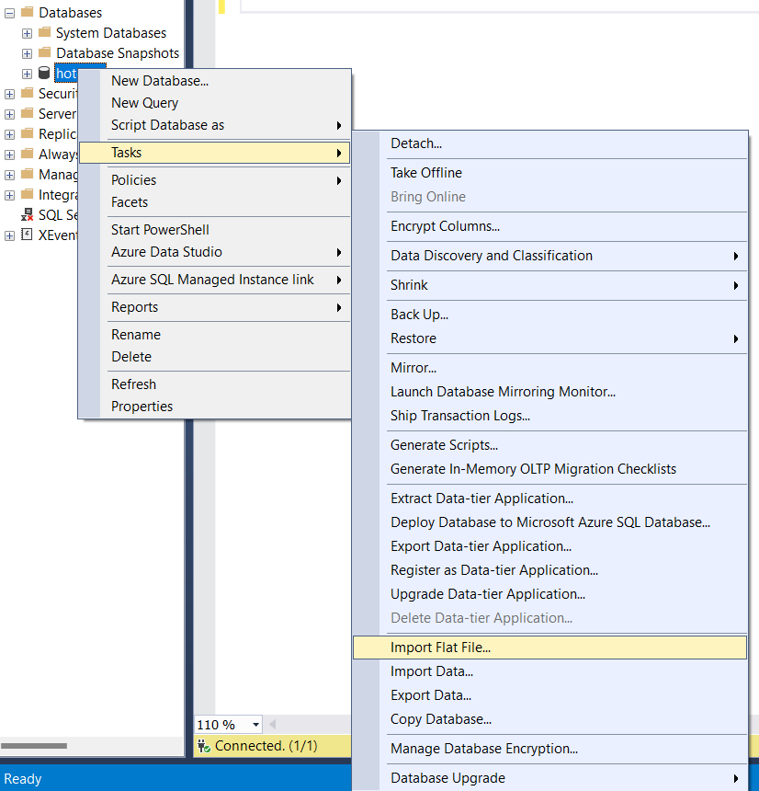
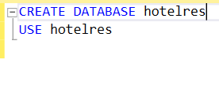
Database Setup

Slide 5
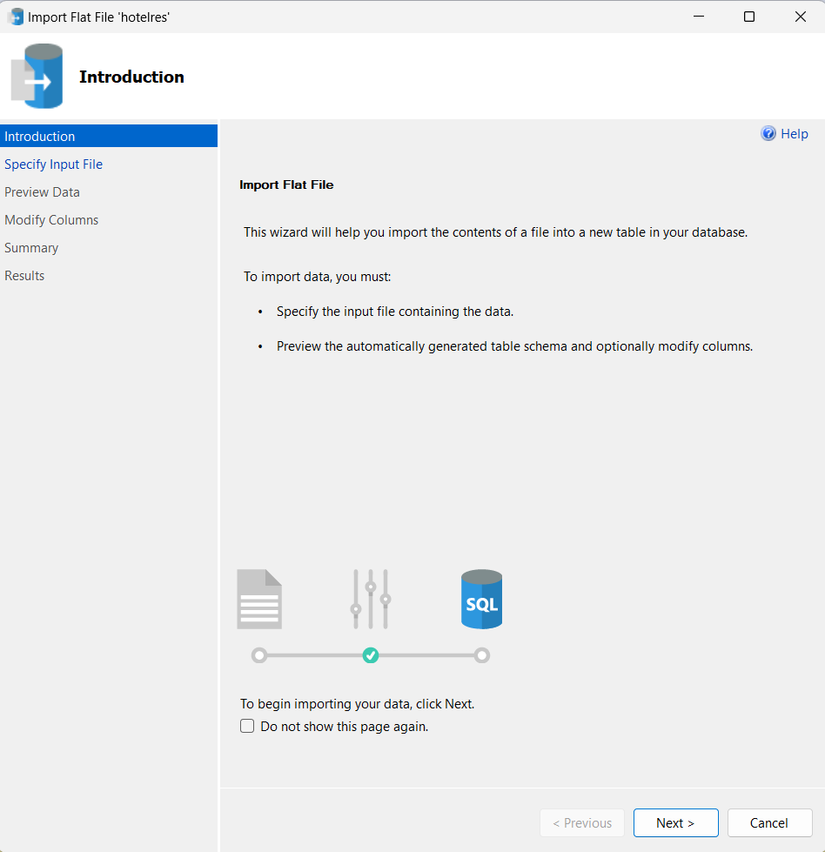
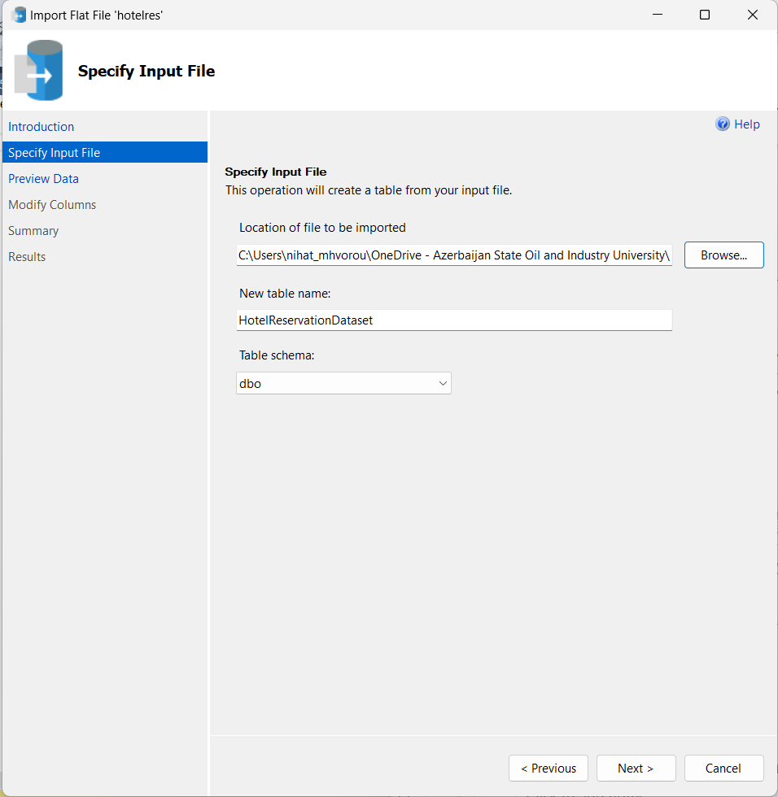
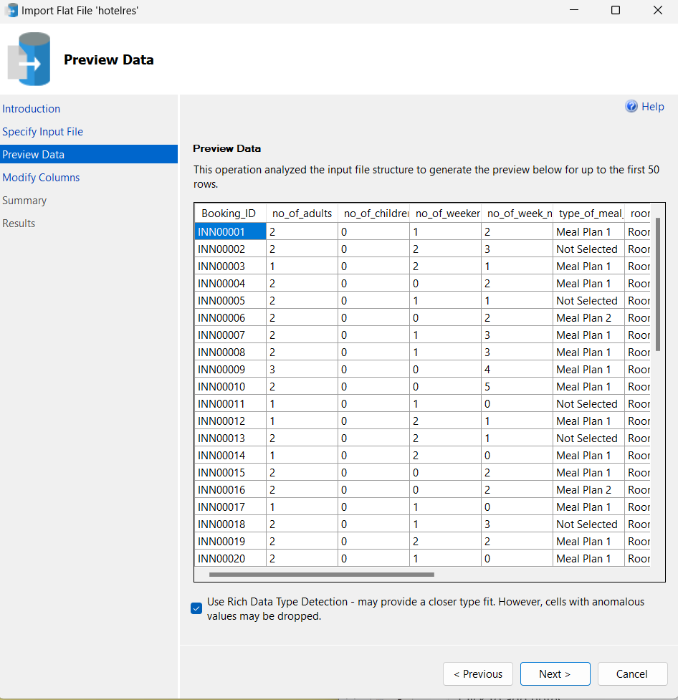
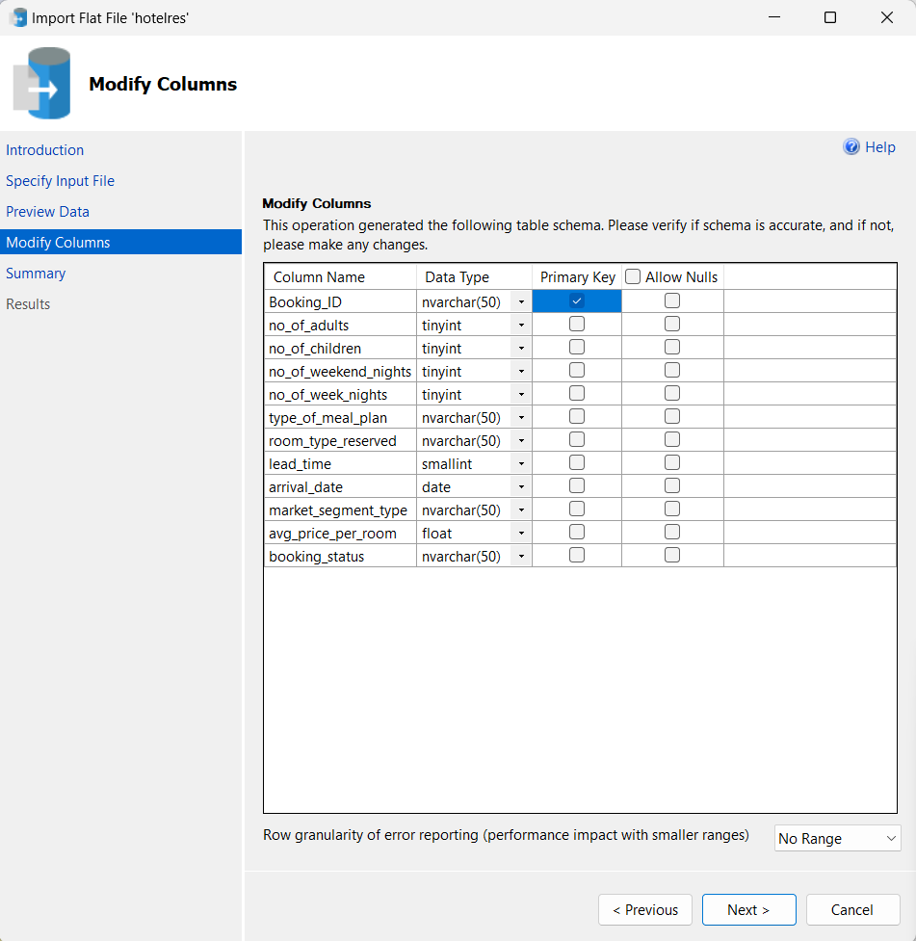
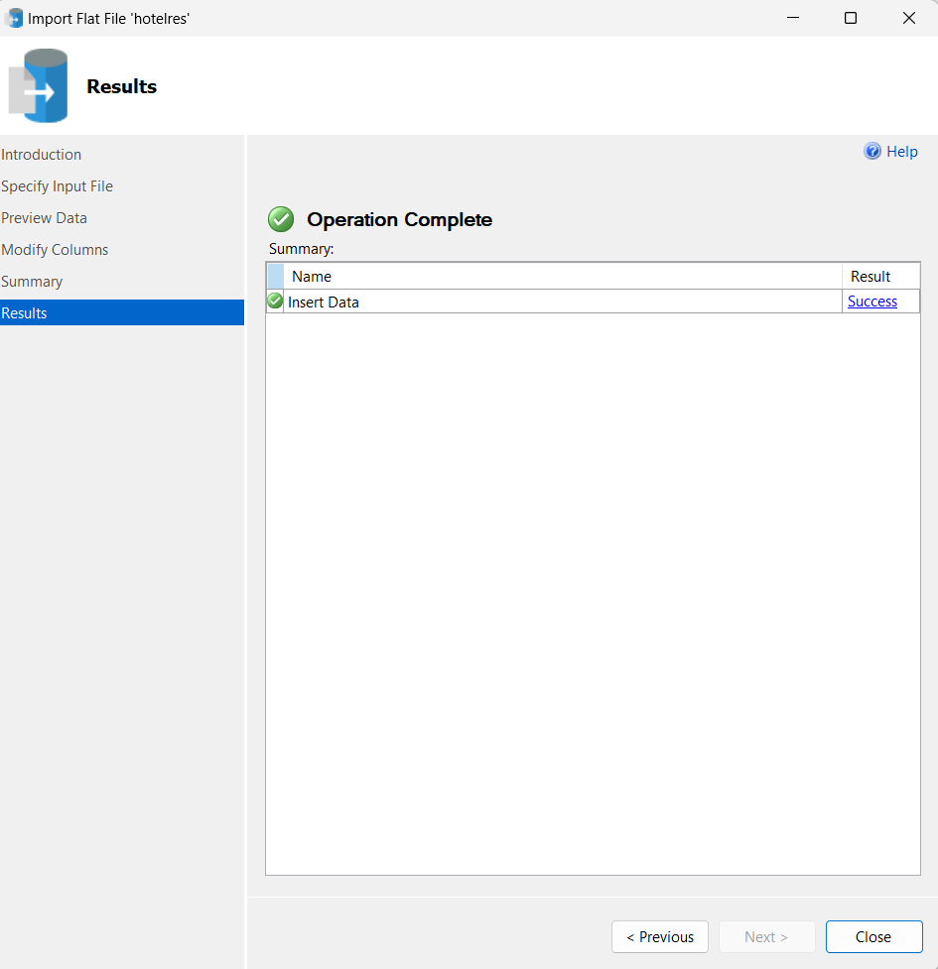
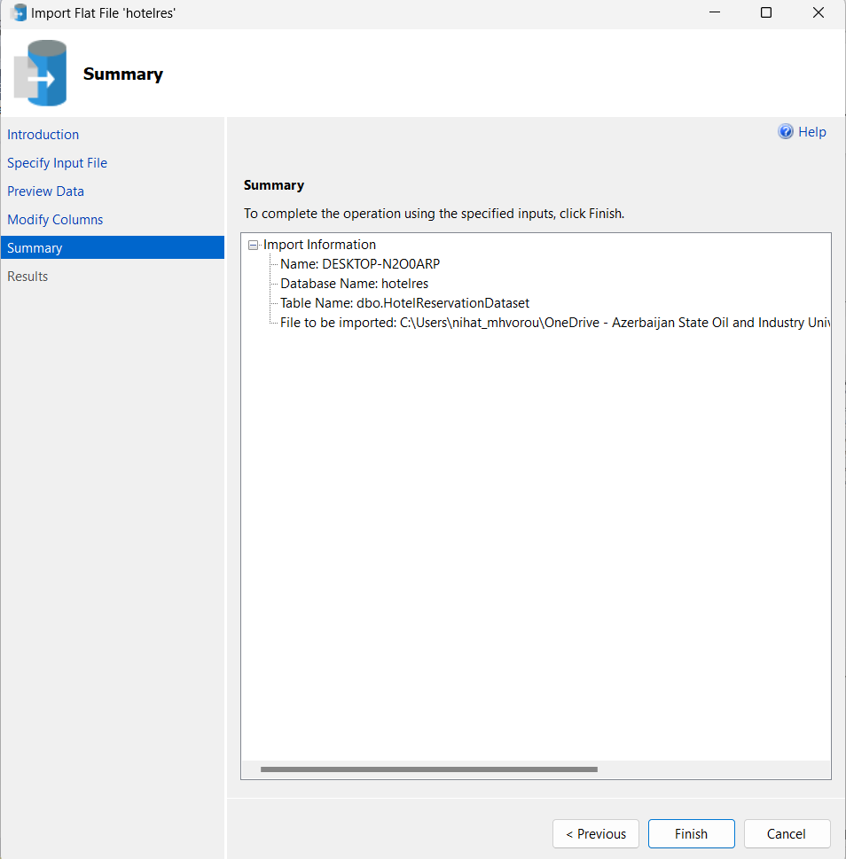
1
2
3
4
5
6

Slide 6

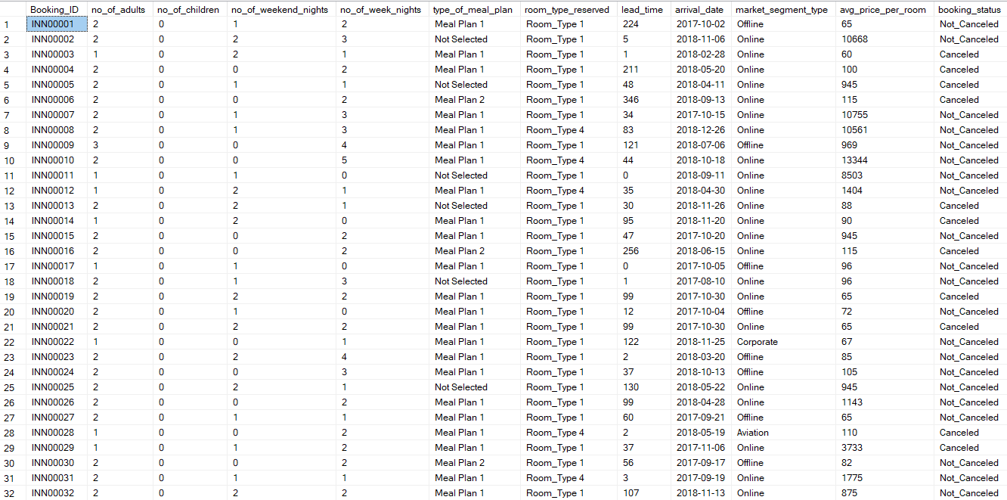
Dataset Owerview

Slide 7
Analysis Questions
Total number of reservations.
Most popular meal plan among guests.
Average price per room for reservations involving children.
Number of reservations for the year 20XX.
Most commonly booked room type.
Reservations falling on a weekend.
Highest and lowest lead time for reservations.
Most common market segment type.
Reservations with booking status "Confirmed."
Total number of adults and children across all reservations.
Average number of weekend nights for reservations involving children.
Reservations made in each month of the year.
Average number of nights spent by guests for each room type.
Most common room type and average price for reservations involving children.
Market segment type with the highest average price per room.

Slide 8


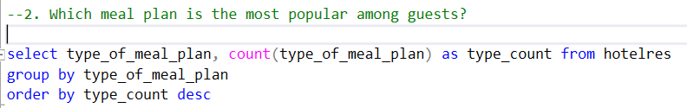

SQL Query Examples

Slide 9


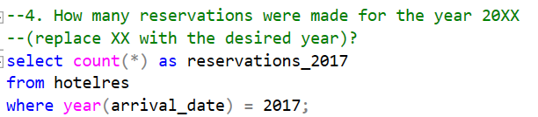

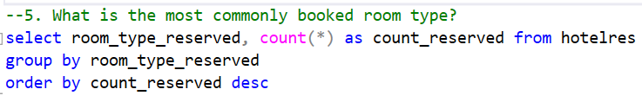
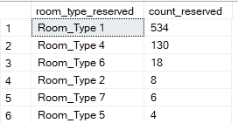

Slide 10

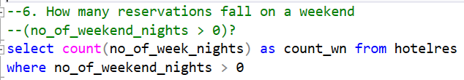


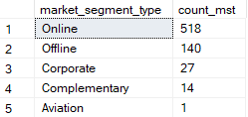
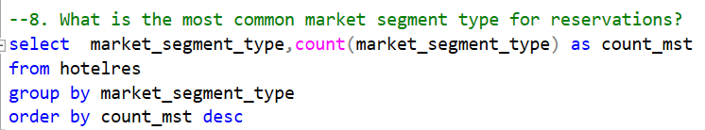

Slide 11






Slide 12
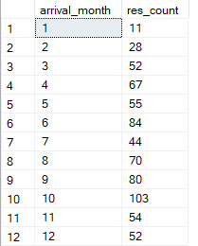
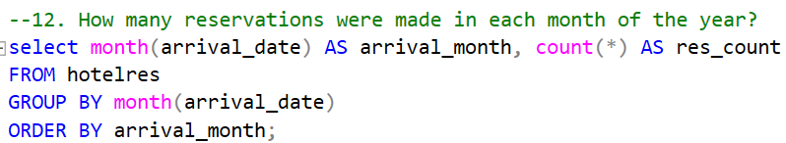
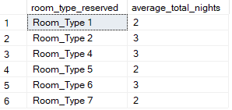
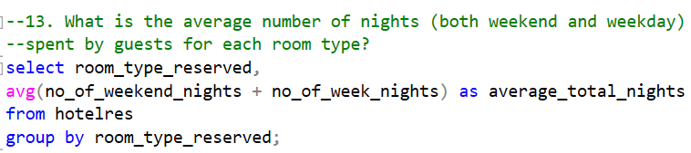

Slide 13
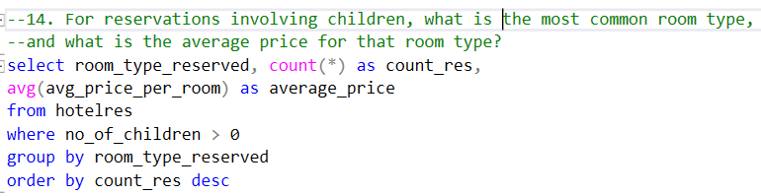
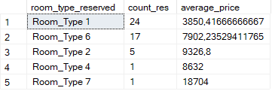

Slide 14
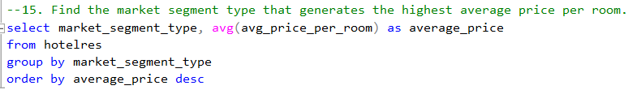
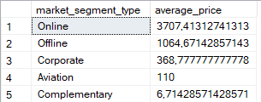

Slide 15
Thank you for attention!

